Slide 1
Top navigation — structure
7 stable items · two open a dropdown on hover/click
Weekly Events
About
Artforms
Experiences
Dropdown ▾
Dropdown ▾
Partnerships & CSR
Dropdown
Artisan Ecosystem
Journal
Enquire
CTA button, not a tab
Artforms dropdown
Experiences dropdown
Traditional
Contemporary
Wellness
Schools & colleges
Corporates
Hospitality & luxury
Online experiences
Partnerships & CSR
Capacity Building
Gifting
Needs Ideation
Note: Corporates (a company booking a workshop) is kept separate from Partnerships & CSR (a funder or CSR head) — same word, two different visitors and two different pitches.

Slide 2
Homepage — desktop section flow
Ten sections in scroll order
1
Hero
6
Partnerships & CSR band
Full-bleed video, tagline, dual CTA
Dedicated funder/CSR CTA
2
Manifesto + impact bar
7
Journal teaser
Mission line + 5 credibility stats
3 recent posts, SEO entry point
3
Artforms showcase
8
Enquiry CTA
Traditional / Contemporary / Wellness rows
Corporate vs general enquiry split
4
Experiences by audience
9
Instagram strip
Schools, Corporates, Hospitality, Online
Live social proof
5
Artisan impact + proof
10
Footer
Livelihood story, testimonials, partner logos
Sitemap, contact, WhatsApp, newsletter

Slide 3
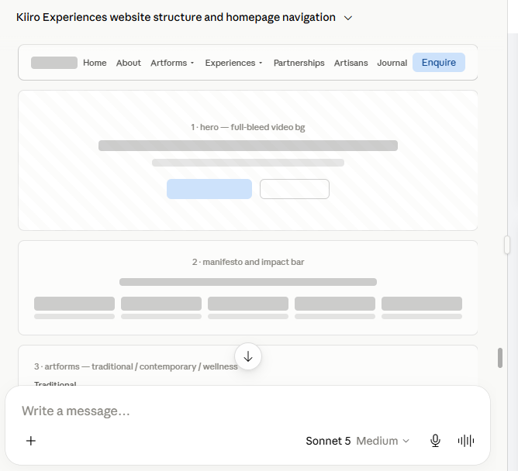

Slide 4
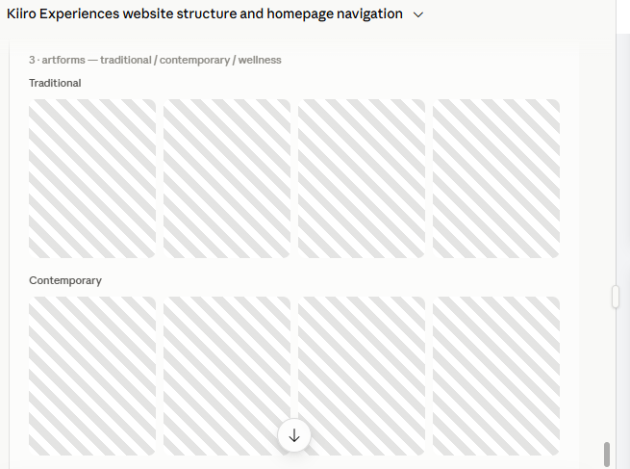

Slide 5


Slide 6
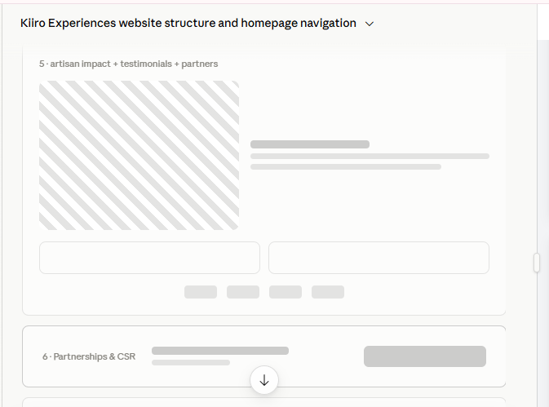

Slide 7
